Slide 1


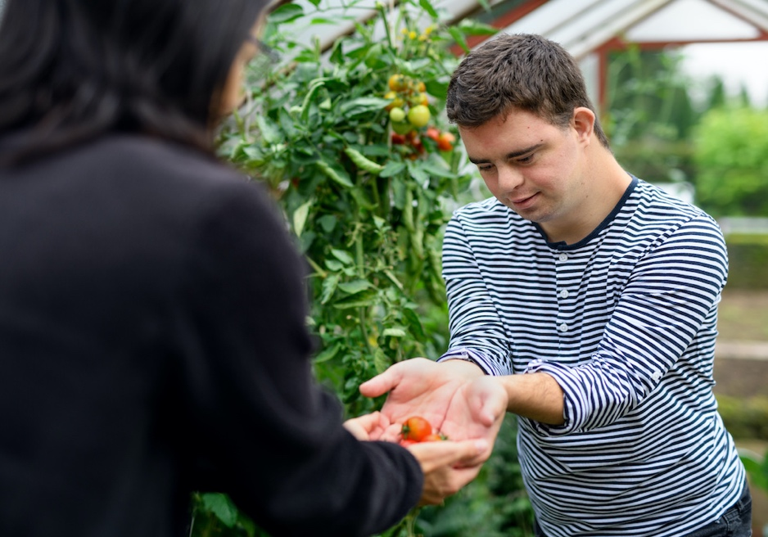
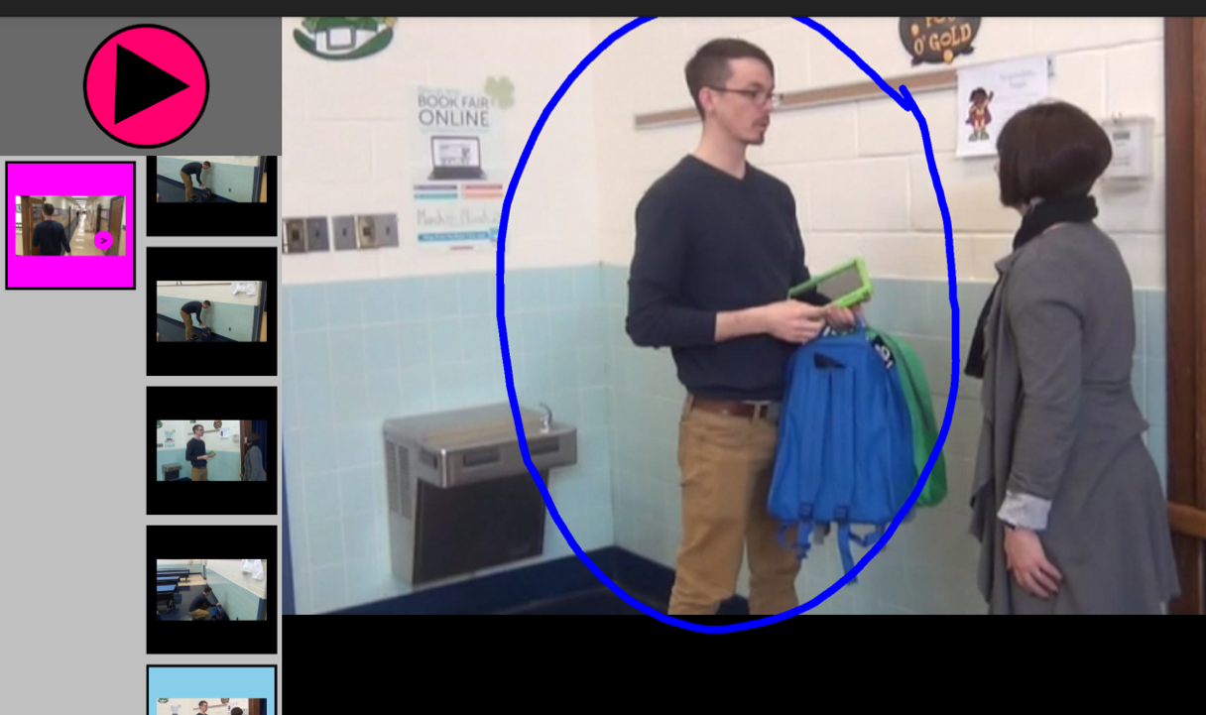
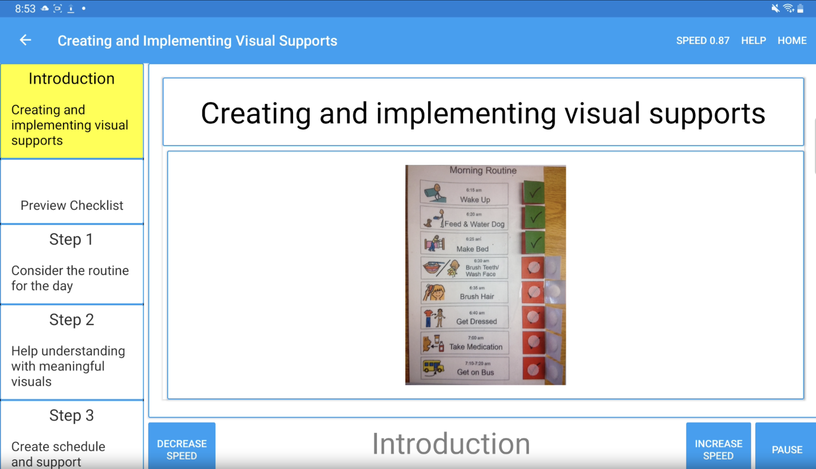
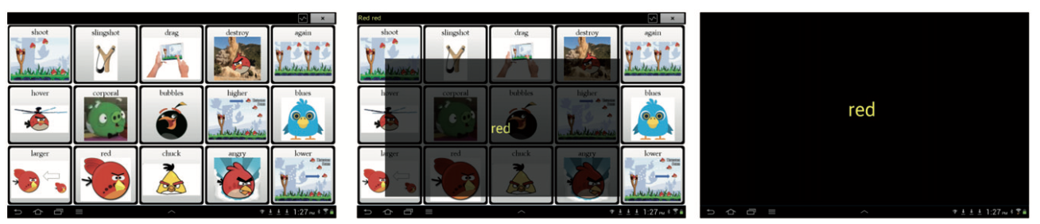
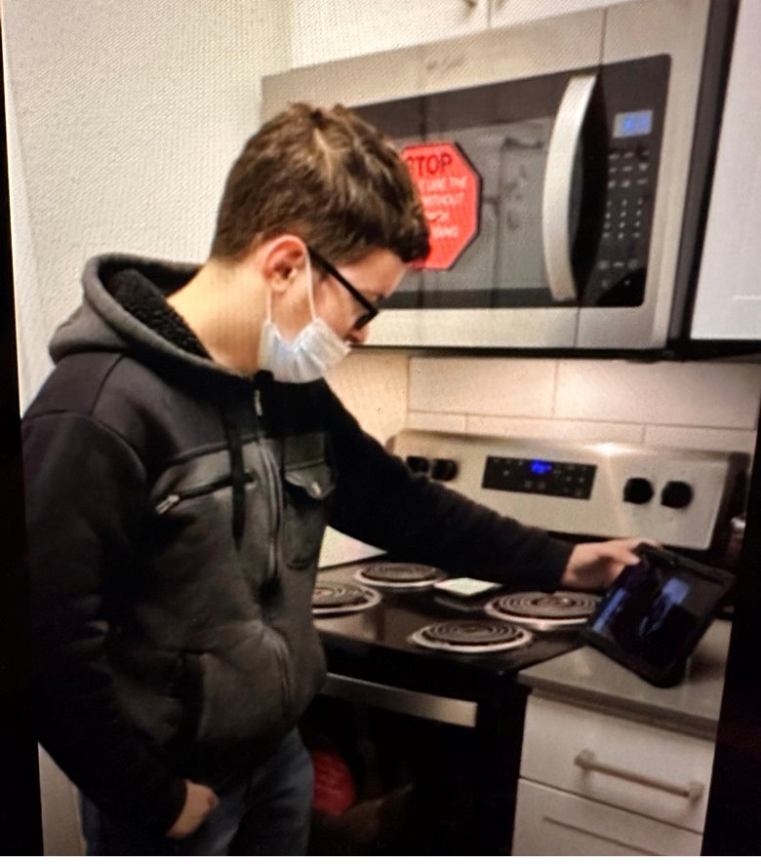
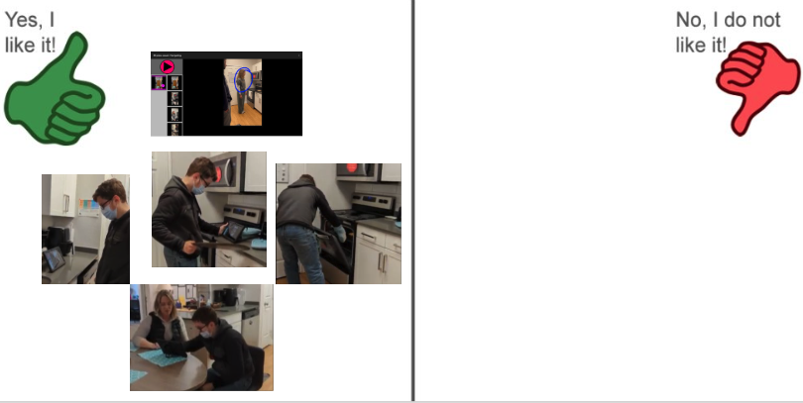
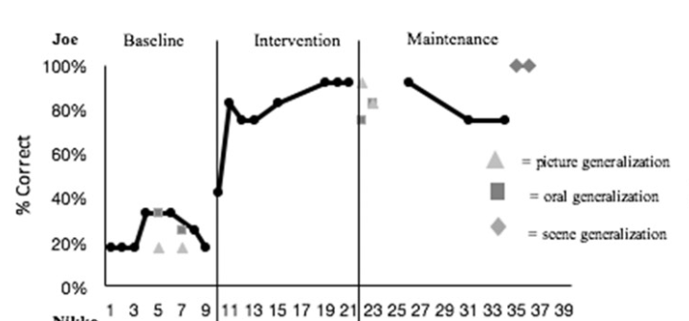
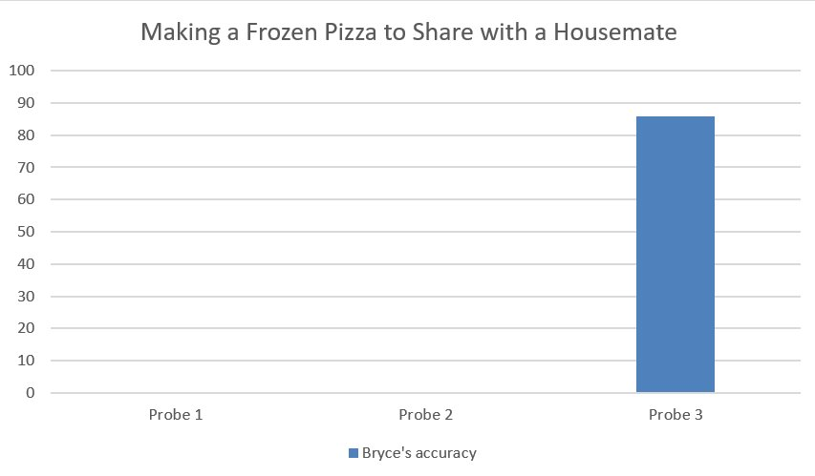

Practical AAC Technologies Supporting Adolescents and Young Adults
Bethany Frick Semmler¹, Sharon Redmon¹, Dawn Sowers¹, Christine Holyfield², David McNaughton¹, and Janice Light¹
¹Pennsylvania State University, ²University of Arkansas
Introduction
Video VSD
Transition to Literacy (T2L)
INSTRUCT – Partner Training
Implications
Only 25-50% of autistic adults are employed (Wehman et al., 2014)
Individuals who cannot rely on speech (have CCN) less than 14% are employed (Nord et al., 2016)
The RERC on AAC has conducted extensive research on three tools that may support adolescents and young adults in this transition age to provide opportunities for communication and community participation.
Video VSDs combine video modeling with communication supports
Participation + Communication
Capture video of events/ interests
Literacy is the pathway to truly generative, independent communication. Yet more than 90% of adults with CCN enter adulthood without functional literacy skills
The T2L feature increases access to literacy concepts at several stages of literacy development and for a range of individuals
Motion and luminance draw attention to the literacy aspect being targeted
New environments (i.e., leaving school, entering new communities, work settings) bring new potential communication partners.
The INSTRUCT app can train professionals, peers, and all communication partners how to support adolescents and young adults with CCN.
Working with adolescents and young adults with disabilities bring unique challenges and opportunities to prepare them for the rest of their lives
Meaningful community participation for individuals with CCN often requires appropriate support – these three technologies offer unique ways to address these support needs
Video VSDs – provide support for both communication and participation
T2L – increases exposure to literacy concepts which are essential to generative, independent communication for individuals who have CCN
Partner Training – provides support to the individuals that interact with the adolescents and young adults with disabilities
Social Validity
Pictured below: social validity (Talking Mats) Video VSD with "Bryce" - reported to enjoy the intervention and using the Video VSD app to learn new things
The sight words used with the T2L were high-interest words that the participants enjoyed talking about
Job coach reported to enjoy using the partner training app
Process of making a video VSD
1) video of an activity is recorded and imported into the video VSD app on a tablet computer;
2) the video VSD app is used to play the video, and to pause the video at key points
• pausing the video creates a still image that can be used as a VSD for communication;
3) hotspots (i.e., a part of the image that speaks when touched) can be added to the VSD and programmed with vocabulary for communication.
Adolescents and Young Adults
Case Study
When students are adolescents or young adults, they need adequate support for the big life changes that come with aging
Video VSDs could be used to teach a wide range of skills to the individuals (e.g., work-related tasks, independent living skills)
Transition 2 Literacy can provide increased exposure to literacy concepts
The INSTRUCT app could be used to train new communication partners (e.g., co-workers, staff) that come with new environments
Joe is a 10 year; 9 month old autistic student. He had an estimated 200 sight words and knew all 26 letter sounds. He participated in a structured matching task.
Results:
Joe completed 8 sessions with 32 total number of exposures to dynamic text
Joe performed with a mean of 23% accuracy at baseline
He improved to an average of 92%; which is a gain of +69%
Case Study
Participants:
Sarah is an autistic young adult in her early 20's participating in a work program
Lisa is also a young adult in her early 20's who is a job coach at the work program.
Method:
Lisa completed a training on how to make and use visual schedules in order to best support Sarah in engaging in the work program
The training took less than 15 minutes and clearly stated the steps for the job coach to complete
Training Steps:
Consider the routine for the day
Help understanding with meaningful visuals
Review the support/schedule
Model the use
Results:
Before intervention, Sarah took approximately 20 minutes to initiate her work tasks
After the intervention, where Lisa was trained on creating visual schedules, Sarah initiated her work task using a visual schedule in less than 5 minutes
Case Study
Barriers
Bryce is 18 and diagnosed with IDD. He participates in an Apartment Program For transition-age students in local HS. He wanted to be able to make a pizza in the oven.
Societal prejudice / attitudinal barriers
Educational barriers
Technological barriers
Policy and funding
Personal care / support service
Transportation (McNaughton, Light, & Arnold, 2002)
Social interactions
Expression of emotions and behavior
Use of AAC technology
Changes in schedules and routines
Acquisition of new skills
Provision of employment supports (Richardson, McCoy, & McNaughton, 2019)
Steps:
“Can you help me make a pizza?”
Walk to oven
Enter numbers on oven and press ‘start’
“Did I get it right?”
Wash hands
Get out tray, place on counter. Get pizza from freezer, unwrap and place on tray
“I am going to put it in the oven”
Put on oven mitts and put pizza in oven
"Did I do it right?”
“Hey Siri, set the timer for twelve minutes”
“I am going to take the pizza out of the oven”
Put on oven mitts, take pizza out of oven. Get plates
Put on oven mitts, get spatula and put pizza on plate
“The pizza is ready; do you want some?”
References
Caron, J., Light, J., Holyfield, C., & McNaughton, D. (2018) Effects of dynamic text in an AAC app on sight word reading for individuals with autism spectrum disorder, Augmentative and Alternative Communication, 34:2, 143-154, http://doi.org/ 10.1080/07434618.2018.1457715
McNaughton, D., Light, J., & Arnold, K. (2002). ‘Getting your wheel in the door’: successful full-time employment experiences of individuals with cerebral palsy who use Augmentative and Alternative Communication. Augmentative and Alternative Communication, 18(2), 59–76. https://doi.org/10.1080/07434610212331281171
Nord, D., Hamre, K., Pettingell, S., Magiera, L. (2018). Employment goals and settings: Effects of individual and systemic factors. Research and Practice for Persons with Severe Disabilities, 43(3), 194-206. https://doi.org/10.1177/1540796918785352
Richardson, L., McCoy, A., & McNaughton, D. (2019). "He's worth the extra work": The employment experiences of adults with ASD who use augmentative and alternative communication (AAC) as reported by adults with ASD, family members, and employers. Work (Reading, Mass.), 62(2), 205–219. https://doi.org/10.3233/WOR-192856
Wehman, P., Chan, F., Ditchman, N., & Kang, H. J. (2014). Effect of supported employment on vocational rehabilitation outcomes of transition-age youth with intellectual and developmental disabilities: a case control study. Intellectual and developmental disabilities, 52(4), 296–310. https://doi.org/10.1352/1934-9556-52.4.296
Joe was one of five adolescent participants in this study, all of whom demonstrated increased accuracy of identification of sight words (Caron et al., 2018)
Results
Bryce completed 86% of the steps after intervention and reported to enjoy the intervention.
Much of the contents of this presentation were developed under a grant from the National Institute on Disability, Independent Living, and Rehabilitation Research (NIDILRR grant number #90RE5017; #90REGE0014) to the Rehabilitation Engineering Research Center on Augmentative and Alternative Communication (RERC on AAC). NIDILRR is a Center within the Administration for Community Living (ACL), Department of Health and Human Services (HHS). The contents of this presentation do not necessarily represent the policy of NIDILRR, ACL, HHS, and you should not assume endorsement by the Federal Government Huge thanks to all the participants and their families, and thanks to the Centre Region Down syndrome Society.
Penn State AAC Doctoral Leadership grant from the U.S. Department of Education (grant #H325D170024). The contents do not necessarily represent the policy of the U. S. Department of Education and you should not assume endorsement.

